Slide 1


.
Logistics Management (PVT. LTD)
Your work is our priority

Slide 2

Who are we ?
Our services provided to our clients with multiple options of the right mix of transit options, cost analysis, and shipment visibility to meet their requirements. We ensure the right vehicle for the product, provide full audit trails, and manage the whole process so that shipment delivers when and where it is needed.
After more than a decade of being a trusted partner to several corporate entities, Senior Solutions has now forayed in another high specialization sector - ATM Management.
ACCENTUATE ATM CUSTOMER EXPERIENCE STANDARDS WITH OUR INNOVATIVE AND SEAMLESS ATM SERVICES
Senior Solutions is a Facility Management Company specialized in Facility Management Services, Housekeeping, Man Power, Security provider, and Logistics. Since our inception in 2010, we are committed to deliver the highest level of service to our customers.

Slide 3

Our promise
Delivering valuable solutions that connect you to world markets. Making logistics simple in a complicated world. Reliable and efficient supply chain services.
ATM network management today is becoming increasingly complex in an ever more cutthroat business environment. Clients expect more services at the ATM, merging in bank and online banking experience.
Transport from the factory to the fulfillment warehouse.
Warehousing and order fulfillment.
Outbound shipping and order delivery to customers.

Slide 4


Nowadays, more prominent inventories mean we must further refine our service and prioritize interaction between people and deliveries.
LOGISTIC CONSULTING
ATM network management today is becoming increasingly complex in an ever more cutthroat business environment. Clients expect more services at the ATM, merging in bank and online banking experience. Digitization has compelled banks to rethink their ATM management strategy.
The most exciting factor regarding ATMs is that there is a new era of opportunities for upgrading any ATM network as a core channel in the redefined banking landscape of today and the future. Hence, banks are increasingly upscaling their ATM strategy and operations to drive business value and competitive advantage.
“ To be an authority & market leader in offering reliable, cost effective & secure worldwide logistics solutions where our customers will benefit from a personalized relationship”

Slide 5


“Warehousing”
We provide secure and spacious warehousing
and logistic support.

Slide 6
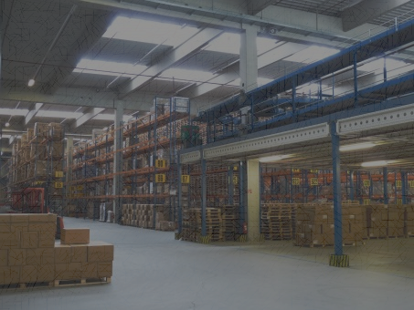
Warehouse operations
ATM SECURITY
Security guard
IT security
MANPOWER
Technician
Camera Installation
Plumber
Electrician
Warehouse Supervisor
Cleaning
Assembling
Maintaining
HOUSEKEEPING SERVICES

Slide 7
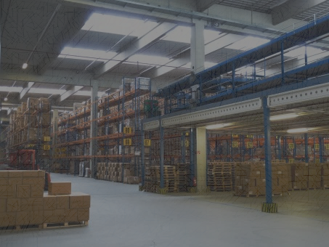
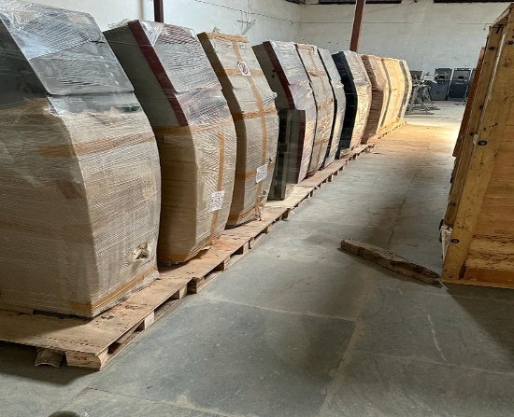
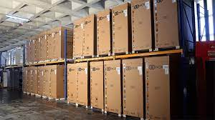
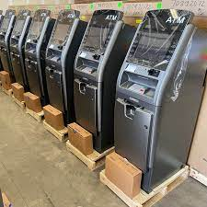
Packaging
PAKAGING
Palletizing
Protective covering
Labelling
Water Proofing
Fragile

Slide 8
“WAREHOUSE SAFETY CULTURE”
ATM STAND are critical pieces of equipment used in warehousing and storage facilities. However, when operated incorrectly can cause serious damage to operators, nearby workers and property.

Slide 9
v
MATERIALS STORAGE Improper stacking of loads and storage of materials on shelves can result in unintended slip and trip hazards for nearby workers. Loads should be placed evenly and properly positioned, heavier loads must be stacked on lower or middle shelves. Always remember to remove one load at a time.
MANUAL LIFTING/HANDLING he most common cause of physical injuries in warehouse and storage facilities involves improper manual lifting and handling. Failure to follow proper procedures can cause musculoskeletal disorders, especially if done with awkward postures, repetitive motions, or overexertion.

Slide 10

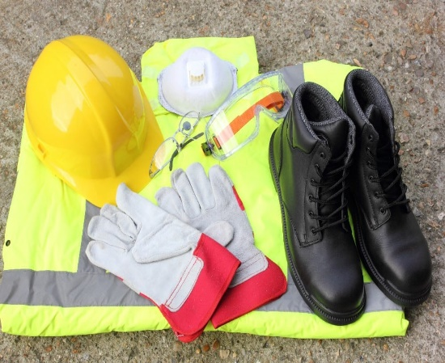
v
CAMERA INSTALLATION ideally composed of members from different departments as frontline ambassadors of safety on the warehouse floor.
IMPLEMENTATION SAFEGUARD Keep secure from potential danger for mechanical power-transmission apparatus such as machine guarding, regular inspections, and proper lubrication.

Slide 11

.
PROJECT MANAGEMENT
Senior Solutions’ comprehensive ATM Management Services portfolio brings together industry best practices, cutting edge tools and service methodologies to increase your top line and bottom line revenues.
SERVICE PORTFOLIO
Site Research
Site Construction and Preparation Site Maintenance and Management Housekeeping Services
Grouting and DE grouting
ATM Installation and Logistics Services ATM Relocation Services
WITH OVER A DECADE OF EXPERIENCE WE OFFER COMPLETE END TO END ATM MANAGEMENT SOLUTIONS.

Slide 12
VALUES
CORE VALUES
INTEGRITY- We are honest and Trustworthy. We accept responsibility for our actions and follow through on promises and commitments.
  CARING ATTITUDE- To form a personal relationship with customers that encourages free flow of feedback on our services standards.
  TIMELINESS - We thrive our challenges and perform our activities with high sense of urgency
  QUALITY- We take pride in what we do and deliver high quality service to our clients and partners.

Slide 13
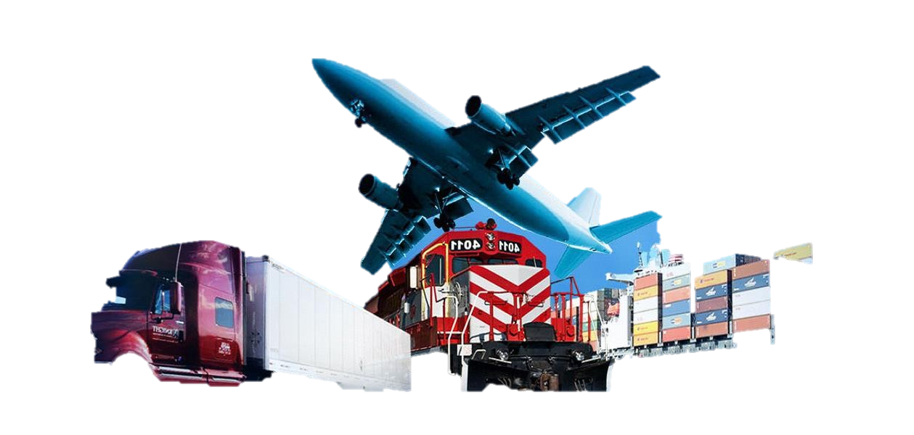
.
MULTIMODAL TRANSPORTATION SOLUTIONS
We offer optimized Multimodal Transportation Solutions by combining several transportation modes across road, sea and air. These modes include conventional as well as containerized railway options. Combining these modes effectively helps reduce cost and ensure safe movement of large volumes.
SERVICE PORTFOLIO
Inland Logistics, Sea Freight and Air Tata Ace, 407, 20ft Container
Primary and Secondary movement PAN India
Reverse Logistics
CHA Support
Integrated Technology for Tracking and Increasing Efficiency
INTEGRATED SOLUTIONS PROVIDE COST EFFECTIVENESS, FLEXIBILITY AND SAFETY.

Slide 14









OUR CLIENTS
They Trust Us

Slide 15





CLIENTS WISE SERVICES DETAILS
HISTORY
CLIENTS WISE SERVICES DETAILS
➢ CMS is our best
company give verious
Project that this
Primary and Secondary Movements PAN India Warehousing PAN India Scrap Pickup PAN India New Machine Delivery PAN India
Secondary Movements PAN India
Scrap Pickup PAN India
Warehousing Movements
Primary and Secondary Movements PAN India
Scrap Pickup PAN India
Primary and Secondary Movements PAN India Warehousing PAN India Scrap Pickup from Mumbai, Delhi, UP
Primary and Secondary Movements PAN India Warehousing PAN India Scrap Pickup PAN India
New Machine Delivery PAN India
Scrap Pickup PAN India
Primary and Secondary Movements PAN India
Scrap Pickup PAN India
Warehousing PAN India
New Machine Delivery PAN India
Scrap Pickup PAN India
Secondary Movements PAN India
www.seniorsolution.in

Slide 16




CONTACT US
+91 251-6630846
+91 8130306697 / +91 9873797551
accounts@seniorsolution.in | rahul@seniorsolution.in deepak@seniorsolution.in
REGD OFFICE: B-26, Street No-3, Phase-1, Shiv Vihar, Delhi-110094.
BRANCH OFFICES: 3rd Floor Near Radhika Market DLF SLF VED
Vihar Ghaziabad.
BRANCH OFFICES: Premia- H Lakehore Green Palava Dombivali East, 421201
Thank You
www.seniorsolution.in

